Slide 1
Operating Systems
SENS-3513
Week: 15
Memory Management 2
Operating System Concepts
9th edition
Silberschatz, Galvin & Gagne
John Wiley & Sons
2013
Dr Nauman Mazhar
Faculty of Information Technology (FIT)
University of Central Punjab (UCP)

Slide 2
Agenda
Memory Management-2
Virtual Memory
Demand Paging
Page Faults
Servicing a Page Fault
Page Replacement Algorithms
2

Slide 3
Introduction to Virtual Memory
Uptil now, we have seen that an entire process is loaded into memory for execution
  right from start, all pages were loaded into memory frames
However, at any time a process is executing only a small amount of its total address space
To conserve memory, load only part of a process in memory
Virtual Memory
technique used by OS, to allow execution of processes
that are NOT completely in memory
  allows to execute programs larger in size than physical memory
3

Slide 4
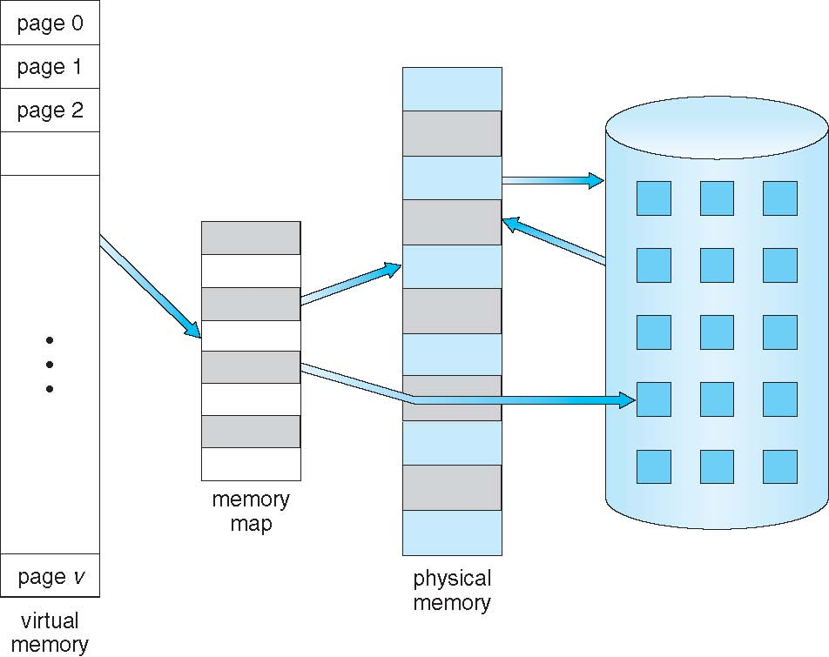
Introduction to Virtual Memory
If entire process (all pages) not loaded for execution
  process might try to access an instruction or data that lies in a page not loaded in memory
  Page Fault – page still in backing store
If page fault…
  OS should
  bring the
  page into memory
4

Slide 5
Introduction to Virtual Memory
When a page is referenced, OS needs to check if page has been loaded in memory, or not
  Page table extended with an extra bit, “present” or “valid”
    if Set → page is loaded → can be accessed
    else → not loaded → need to bring in memory
To load & execute a process, OS needs to perform two tasks:
Page selection
  which page to bring in memory, & when
Page replacement
  if page fault, and no free frame available to store new page
  which page to swap out – victim frame
5

Slide 6
Introduction to Virtual Memory
Approaches to Page Selection
  Demand Paging
    bring a page in memory when referenced
    start process with no page loaded – load on page fault
  Pre Paging
    bring a page in memory before it is referenced
    when one page is referenced – bring next one too
  Request Paging
    let user say which page is needed
    but user doesn’t always know best
Approaches to Page Replacement
  effective page replacement algorithm
  FIFO, Optimal, LRU, LFU (to be studies…)
6

Slide 7
Demand Paging
Demand paging…
“bring a page into memory only when it is needed”
Advantages of demand paging…
  potentially less memory needed for each process
  higher degree of multiprogramming
7
Notes:
Lazy Swapper – never swaps a page into memory unless the page will be needed

Slide 8
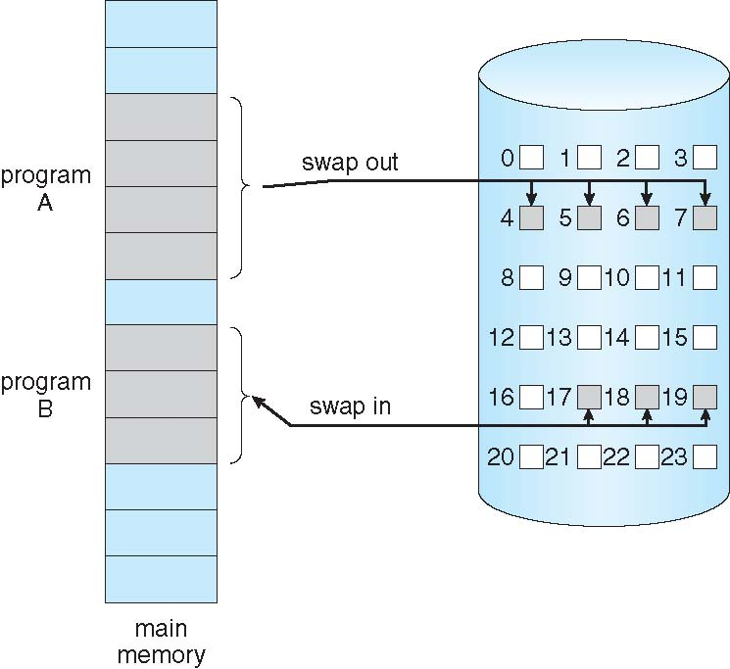
Demand Paging
Demand paging is similar to paging with swapping
8

Slide 9
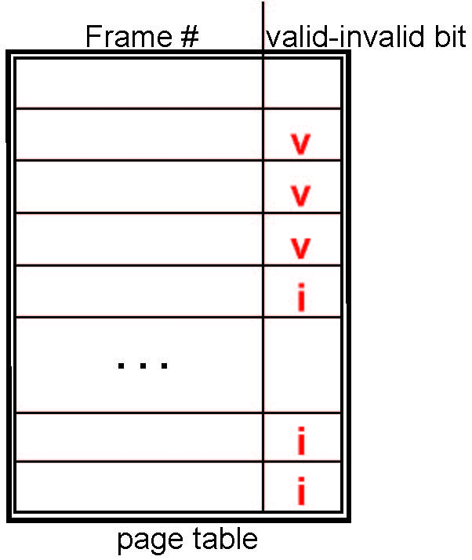
Demand Paging
When page is needed, consult the page table
Each page table entry has a valid - invalid bit
v → page in memory
(memory resident)
i → page not in memory
(page fault)
Initially, value of the bit on all
entries is set to i
As pages are loaded, the bit is
set to v
9

Slide 10
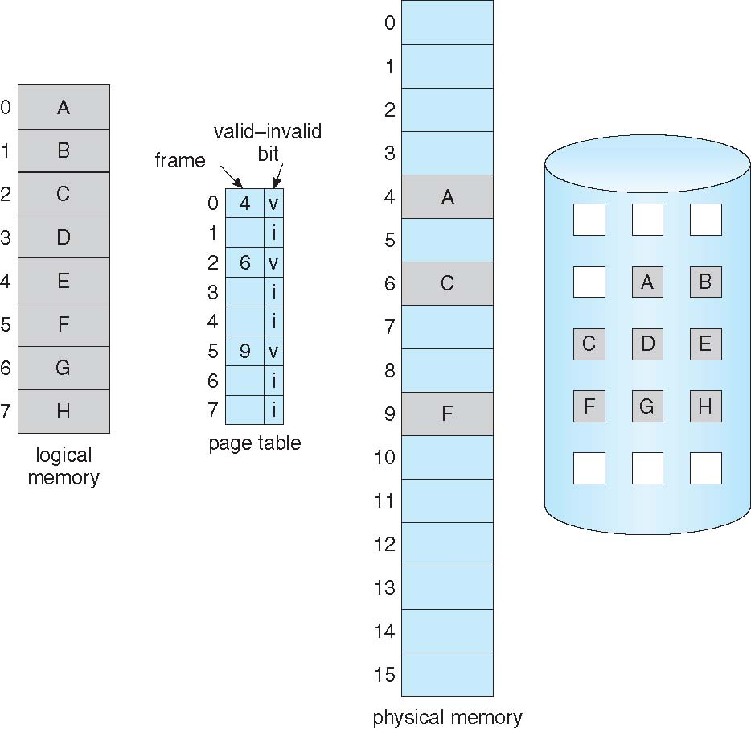
Page Table - Some Pages not in Memory
10

Slide 11
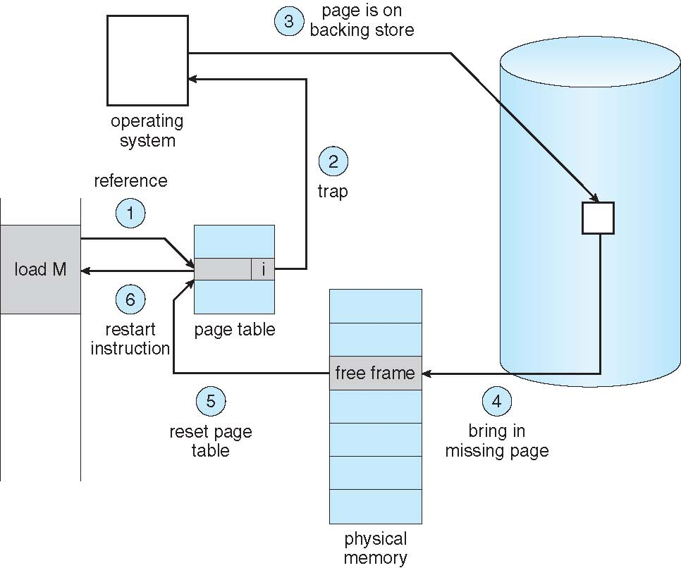
Servicing a Page Fault
When page referenced, OS checks to see:
If ref is invalid:
  trap to OS
  abort process
If ref is valid:
  check valid bit of
  page
  if valid bit == 0,
  page not in
  memory
  page fault
  trap to OS
  service page fault
(may need page
replacement)
11

Slide 12
Servicing a Page Fault
Page fault servicing:
Locate page on disk
Allocate a free frame,
& load the page
If no free frame,
select victim frame,
& swap out to disk
Swap in desired page
in selected frame
Store frame number
in PTE, & set valid bit
Restart instruction
(may need page
replacement)
12

Slide 13
Page Faults & No Free Frame
Page faults negatively impact system performance
  want lowest page fault rate
  need effective page replacement algo to ensure required pages are available in memory
Types of page replacements
  Local replacement
    if process P1 has no free frame, & demands a page
    victim frame selected is of the same process P1
  Global replacement
    if process P1 has no free frame, & demands a page
    victim frame selected is of some other process
13

Slide 14
  Page Replacement Algorithms
14

Slide 15
Page Replacement
OS needs to decide regarding fetch, placement & replacement of pages…
  Fetch Strategies
    when should a page be brought into memory
    (demand, pre-paging & request)
  Placement Strategies
    where should a page be placed in main memory
  Replacement Strategies
    which page be swapped out to disk, if no free frame available
    (replacement algos; FIFO, Optimal, LRU, …)
15

Slide 16
Evicting the Best Page
Goal of page replacement algo…
  reduce page fault rate by selecting the best page to evict
  best pages are those that will never be used again
Principle of Optimality:
  “replace the page that will not be used again
  the farthest time in future”
  possible only if future access patterns are known
  but generally do not know this…!!!
Need to evaluate page replacement algo for lowest page fault rate
“run the algo on a particular string of memory references,
and compute number of page faults on that string”
16

Slide 17
Page Replacement Algos
FIFO – First in First Out
  Replace the page that has been in memory the longest
Optimal
  Replace the page that won’t be used for longest time in future
LRU – Least Recently Used
  Replace the page that has not been used for the longest time
LFU – Least Frequently Used
  Replace the page that has been used least often
Random Page Replacement
  Choose a page randomly
17

Slide 18
First in First Out
Simplest algorithm…
“when a page is to be replaced,
the oldest one is chosen”
Instead of recording the time when a page is brought in, we use a FIFO queue
Suffers from Belady’s anomaly:
“for some page replacement algorithms,
by increasing the number of frames allocated to a process,
page fault rate may increase”
18

Slide 19
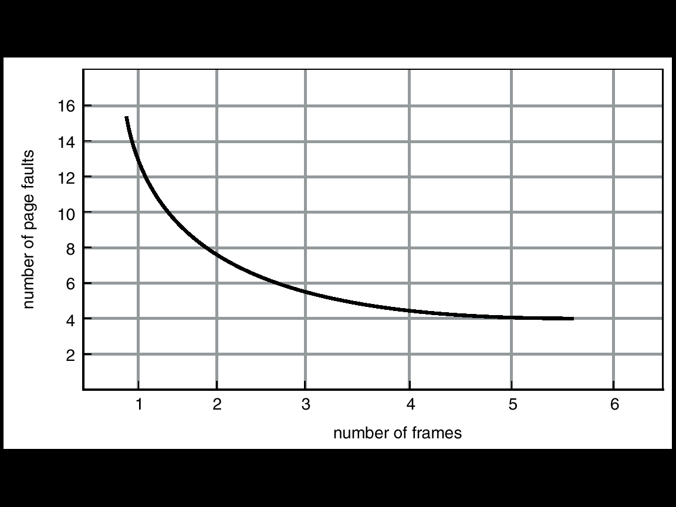
Belady’s Anomaly
Given a reference string, it would be natural to assume that:
the more the total number of frames in main memory,
the fewer the number of page faults
Not true for some algos,
like FIFO
Belady’s anomaly:
for some page replacement algos,
by increasing the number of frames
allocated to a process,
page fault rate may increase
19

Slide 20
First in First Out
A sample string showing Belady’s anomaly in FIFO algorithm
Number of frames allocated = 3
Reference string:
1, 2, 3, 4, 1, 2, 5, 1, 2, 3, 4, 5
Number of page faults = 9
1 | 1 | 1 | 4 | 4 | 4 | 5 | 5 | 5
 | 2 | 2 | 2 | 1 | 1 | 1 | 3 | 3
 |  | 3 | 3 | 3 | 2 | 2 | 2 | 4
Number of frames allocated = 4
Reference string:
1, 2, 3, 4, 1, 2, 5, 1, 2, 3, 4, 5
Number of page faults = 10
increased frame allocation,
increased page faults
1 | 1 | 1 | 1 | 5 | 5 | 5 | 5 | 4 | 4
 | 2 | 2 | 2 | 2 | 1 | 1 | 1 | 1 | 5
 |  | 3 | 3 | 3 | 3 | 2 | 2 | 2 | 2
 |  |  | 4 | 4 | 4 | 4 | 3 | 3 | 3
20

Slide 21
Optimal
Best possible algo, but impossible to implement
“Replace the page that will not be used
for the longest period of time”
Has the lowest page fault rate
Does not suffer from Belady’s anomaly
But is unrealizable…
at the time of page fault, OS has no way of knowing
when a page would be referenced next
Used as bench mark…
  to evaluate a page replacement algo, its performance is compared with that of optimal
21

Slide 22
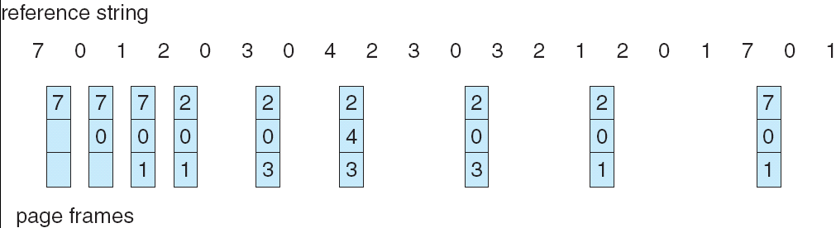
Optimal
Given the reference string, compute number of page faults for Optimal replacement algo
Number of frames allocated is 03
22

Slide 23
Least Recently Used
Approximation of Optimal algo
  assumes pages not used for ages, will probably remain unused for a long time
“replace the page not been referenced for the longest time”
Example:
  Number of frames allocated = 3
  Reference string: 1, 2, 3, 4, 1, 2, 5, 1, 2, 3, 4, 5
  Number of page faults = 10
1 | 2 | 3 | 4 | 1 | 2 | 5 | 1 | 2 | 3 | 4 | 5
1 | 1 | 1 | 4 | 4 | 4 | 5 | 5 | 5 | 3 | 3 | 3
 | 2 | 2 | 2 | 1 | 1 | 1 | 1 | 1 | 1 | 4 | 4
 |  | 3 | 3 | 3 | 2 | 2 | 2 | 2 | 2 | 2 | 5
23

Slide 24
Page Replacement Algorithms
Drawbacks of FIFO
A page being accessed quite often, may also get replaced
  as it arrived earlier than those present
Ignores locality of reference
  recently referenced page may also get replaced
  although probability is high same page may be needed again
Drawbacks of LRU
Scheme takes care of locality of reference, and replaces dormant pages
But a frequently accessed page may also get replaced
  due to not being accessed for some time
  being a significant page, may be needed in the very next access
24

Slide 25
Sample Problems
Problem: Compute total page faults for the given page Trace for 4 frames, using following algorithms:
  FIFO, Optimal, and LRU
  Page Trace/Reference String is given below:
  2, 3, 4, 5, 6, 4, 5, 2, 7, 8, 9, 4, 9, 0, 8, 9, 1, 6, 5, 6, 5, 3
Problem: Compute total page faults for the given page Trace for 3 frames using FIFO, Optimal, and LRU algorithm with:
  6, 5, 4, 3, 0, 6, 5, 1, 3, 2, 5, 6, 4, 3, 2, 1, 6, 0, 3, 4, 1, 6
Problem: Compute total page faults for the given page Trace, using FIFO, Optimal, and LRU algorithm :
8, 9, 0, 1, 2, 0, 1, 8, 3, 4, 5, 0, 5, 6, 4, 5, 7, 2, 1, 2, 1,9
  Do it using 4 frames and then using 3 frames
25

Slide 26
Use of “dirty bit” in PTE
Page Table Entry has a “dirty bit”
  used to reduce the overhead of page transfers, when a page is to be swapped out to hard disk
Dirty bit
  set by hardware – when data is written to a page
  checked by OS – at page replacement time
When page is to be swapped out
  only the modified pages are written back to disk
26

Slide 27
Performance of Demand Paging
Consider that p is the probability of page fault occurring
  page fault rate will lie between, 0 ≤ p ≤ 1
    if p = 0 no page faults
    if p = 1 every reference is a fault
Effective Access Time (EAT)
EAT =
(probability of no page fault)
*
(memory access time)
+
(probability of page fault)
*
(page fault service time)
EAT =
(1 - p)
*
(MAT)
+
(p)
*
(page fault overhead +
swap out time +
swap in time +
restart overhead)
27

Slide 28
Performance of Demand Paging
Problem
Consider a system with Memory Access Time of 100 nanosecond. One out of 1000 accesses causes a Page Fault (p = 1/1000), and total Page Fault Service Time is 25 millisecond. Calculate Effective Access Time. Discuss how much the system will be slowed down.
T_{effective} = (1 - p) * 100 + p (25 x 10⁻³)
= (1 - 1/1000) * 100 ns + 1/1000 * 25 ms
= (1 - 1/1000) * 100 ns + 1/1000 * (25 x 10⁻³)
= 99.9 ns + 25000 ns
= 25099.9 ns ≈ 25000 ns
system is slowed down 250 times,
by just one page fault out of 1000 page accesses
28

Slide 29
Exploiting Locality
Temporal Locality
  memory locations accessed recently, likely to be accessed again soon
Spatial Locality
  memory locations near recently accessed memory locations, likely to be accessed soon
Locality helps keep subset of data in more accessible location
  caching – reduces frequency of page swapping
  once something is in memory, should be used many times
Key goal: maximize cache hit rate, minimize page fault rate
29

Slide 30
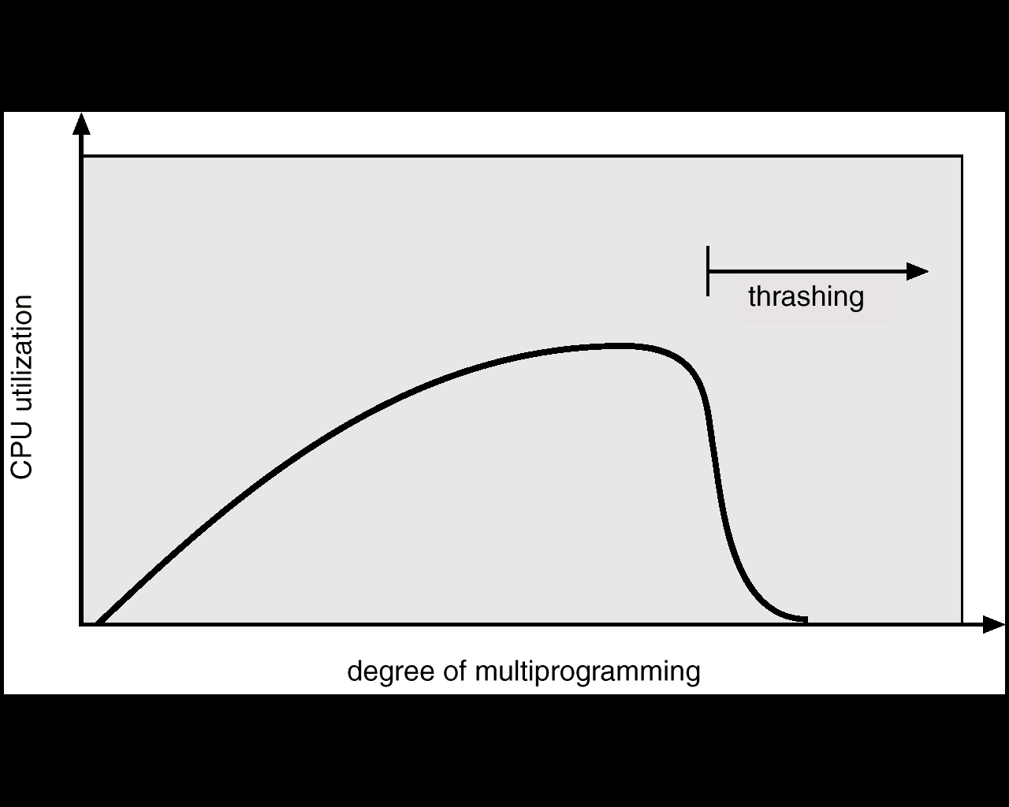
Thrashing
If a process does not have “enough” frames, page-fault rate is high
  low CPU utilization
OS thinks, it needs to increase degree of multi-programming
  another process is added to system, causing further problems
Thrashing – when CPU spends much of its time
swapping pages in and out, rather than executing instructions
30

Slide 31
Thrashing
To prevent thrashing:
  degree of multiprogramming needs to be reduced
Thrashing can also be reduced by using local page replacement
  if one process starts thrashing, it cannot steal frames from another process, & cause it to thrash too
Thrashing results in severe performance problems:
  low CPU utilization
  high disk utilization
  low utilization of other
  I/O devices
31

Slide 32
Thrashing Example
Consider a process using LRU page replacement, with 3 frames
Ref string is: 1234123412341234………..
4th access onwards, all cause page fault
What do humans do when thrashing
  if flunking all courses at midterm time, withdraw one or two
What does OS do
  if a single process is too large for memory, there is nothing OS can do, & process will simply thrash
  if problem arises because of sum of several processes
    figure out how much memory each process needs
    change scheduling priorities to run processes in groups, such that memory needs can be satisfied
32

